Slide 1

Student Mental Health: Promotion, Advocacy & Education
Marta Cooper Burt, MI Candidate
Robyn Forman, MI Candidate
Kathleen Scheaffer, Outreach and Instructional Librarian

Slide 2
Agenda
Why focus on student mental health
iStudents for Mental Health
Dual Continuum Model
Implementation of several mental health initiatives
  process
  considerations
Brainstorm your library
Questions

Slide 3


Screenshot from: https://istudentsformentalhealth.com

Slide 4
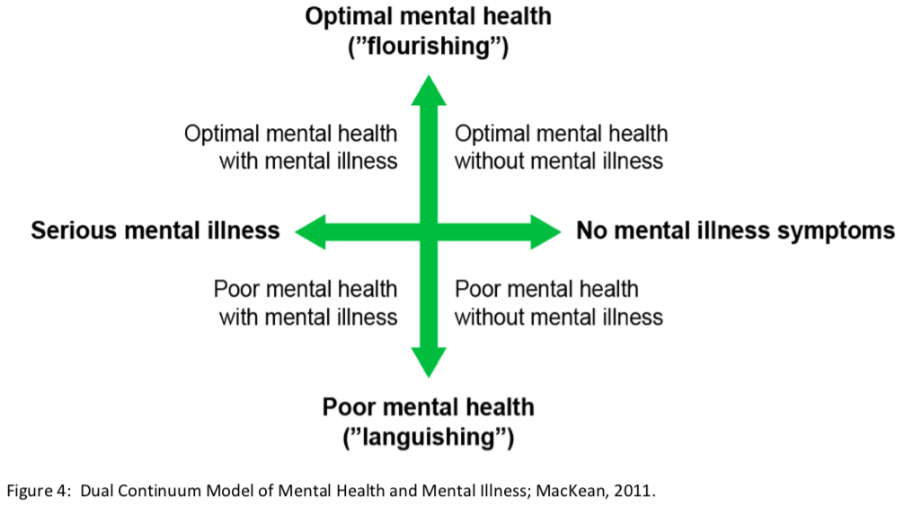
Mental Health Framework
Screenshot from page 12: https://www.provost.utoronto.ca/wp-content/uploads/sites/155/2018/03/Report-on-Student-Mental-Health.pdf

Slide 5
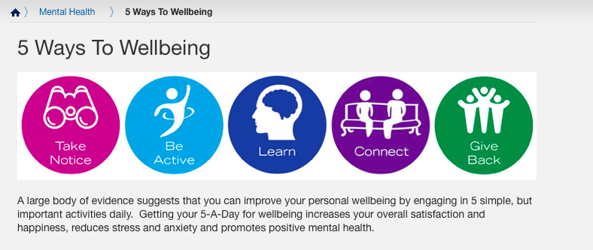
Mental Health Promotion:
5 Ways to Wellbeing
Screenshot from: https://www.utm.utoronto.ca/health/health-promotion/mental-health/5-ways-wellbeing

Slide 6
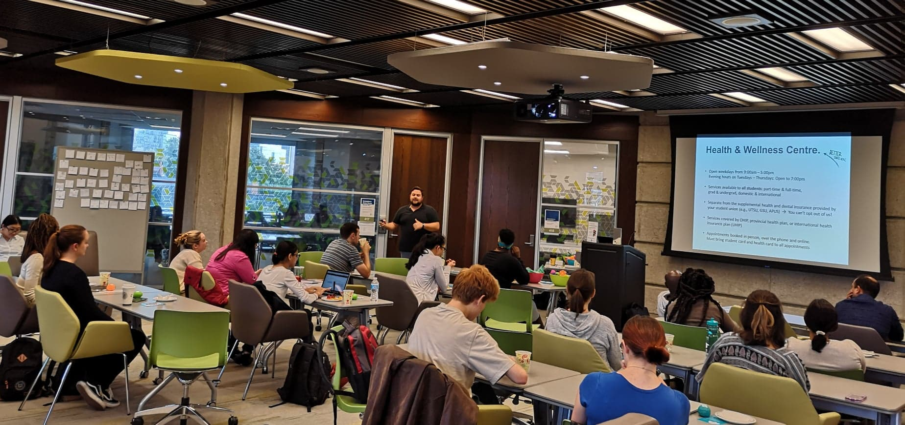
Mental Health Promotion:
5 Ways to Wellbeing
Photo credit: Robyn Forman

Slide 7







Mental Health Advocacy:
Support, Policy, and Connection

Slide 8

Mental Health Advocacy

Slide 9
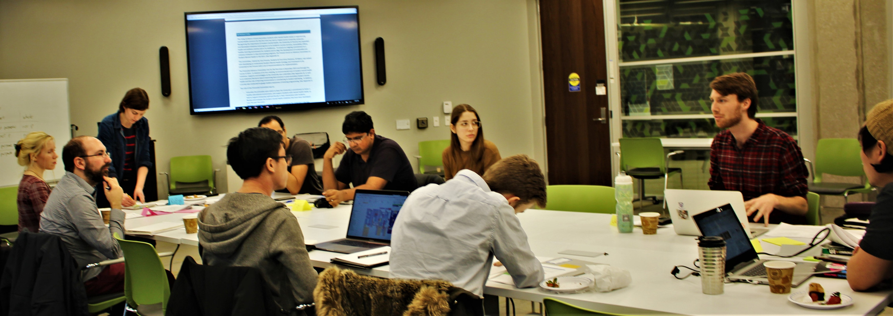
Mental Health Advocacy
Photo credit: Eden Rusnell

Slide 10
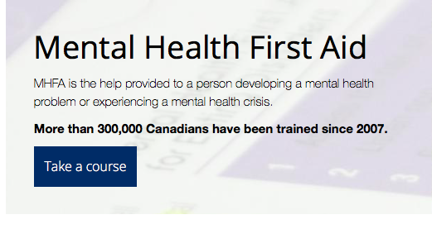
Mental Health Education: MHFA
Screenshot from: https://www.livingworks.net/programs/safetalk/

Slide 11
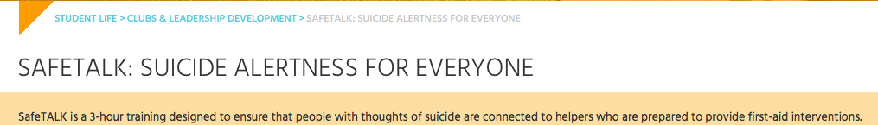
Mental Health Education: safeTALK
Screenshot from: https://www.studentlife.utoronto.ca/cld/safetalk

Slide 12

Librarian Models Lesson: Reach Back

Slide 13
Considerations:
Getting Started
Scan the available resources and programming in your community
Participate in mental health groups, programs, training and/or events
Connect with decision makers, students, and/or student groups about mental health
Review policies concerning mental health

Slide 14
Considerations:
Implementation and Review
Time (Planning, Time of year, Competing events, Travel time)
Location (Promotional materials, Venues)
Established structures (Programs, Promotional venues, Systems)
Funding (Budgets, Grants)
Assessment (Metrics, Focus groups, Surveys, Reflection papers)

Slide 15

Mental Health Promotion, Advocacy, and Education:
Brainstorm Your Library
    What you can do on Monday to showcase mental health as a priority in your library?
    Which folks could you reach out to on Monday to get the ball rolling?
    Would any of the initiatives shared in the presentation be replicable in your community?
    Are there initiatives in your community that you could attend, remix, or integrate?
    Which considerations really stood out for you?
    What additional considerations should be added to the list provided?

Slide 16


Questions? Suggestions? Thoughts?

Slide 17
Helpful Links
iStudents for Mental Health
  https://istudentsformentalhealth.com/
  https://www.facebook.com/groups/iStudentsForMentalHealth/
Inforum Library
  https://inforum.library.utoronto.ca/
ACHA/NCHA Spring 2013 Reference Group Executive Summary
  https://www.acha.org/documents/ncha/ACHA-NCHA-II_ReferenceGroup_ExecutiveSummary_Spring2013.pdf
Report of the Provostial Advisory Committee on Student Mental Health
  https://www.provost.utoronto.ca/wp-content/uploads/sites/155/2018/03/Report-on-Student-Mental-Health.pdf
5 Ways to Wellbeing via the UTM Health & Counselling Centre
  https://www.utm.utoronto.ca/health/health-promotion/mental-health/5-ways-wellbeing
safeTALK
  iSkills workshop: https://inforum.library.utoronto.ca/workshops/safe-talk-certificate-program-suicide-alertness
  University of Toronto Link for Organizing at U of T: https://www.studentlife.utoronto.ca/cld/safetalk
  How to organize this workshop in your area https://www.livingworks.net/programs/safetalk/
Mental Health First Aid Canada
  https://www.mhfa.ca
Wellness Recovery Action Planning (WRAP)
  https://reddeer.cmha.ca/programs-services/wrap-wellness-recovery-action-planning/
Stella’s Place
  https://stellasplace.ca/

Slide 18
Helpful Links
Helpful Links
University of Toronto Mandatory Leave
  http://www.governingcouncil.lamp4.utoronto.ca/wp-content/uploads/2018/06/p0627-umloap-2017-2018p.pdf
Facebook Group for UMLAP
  https://www.facebook.com/groups/mandatory.leave.response/
Resource Bibliographies for UMLAP Student Group
  https://bit.ly/2UrA0OD
University of Toronto Faculty Association Open Letter Regarding UMLAP
  https://www.utfa.org/sites/default/files/Sandy%20Welsh%20let%2015_Dec_17_no%20signature.pdf
iRelax
  http://uoft.me/irelax
Mindful Moments
  http://uoft.me/mindful-moments

